Slide 1

TUNE IN
ABINAYA K
727822TUCS003
COMPUTER SCIENCE ENGINEERING
GUIDED BY
MENTORED : MR.R.MANOPALANIRAJA
MENTOR : MRS.P.KALPANA

Slide 2

ABSTRACT
This website is dedicated to all music enthusiasts, providing a platform for music lovers to explore, discover, and connect with new artists and songs.
With a comprehensive library of musical genres ranging from classical to pop, the website caters to a diverse audience.

Slide 3

MODULES ADDED
LOGIN PAGE
HOME PAGE
SEARCH BY ARTIST PAGE
JAVA SCRIPT ALERT
COMMENT PAGE
ABOUT PAGE

Slide 4
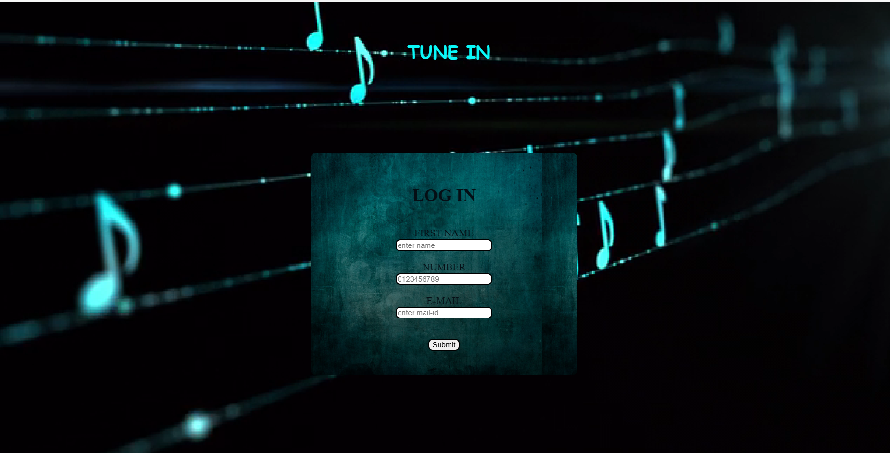
LOGIN PAGE
When User enters our website he will be asked about his login details like email id and mobile number . The login details will be verified with the details given while the user creates an account

Slide 5
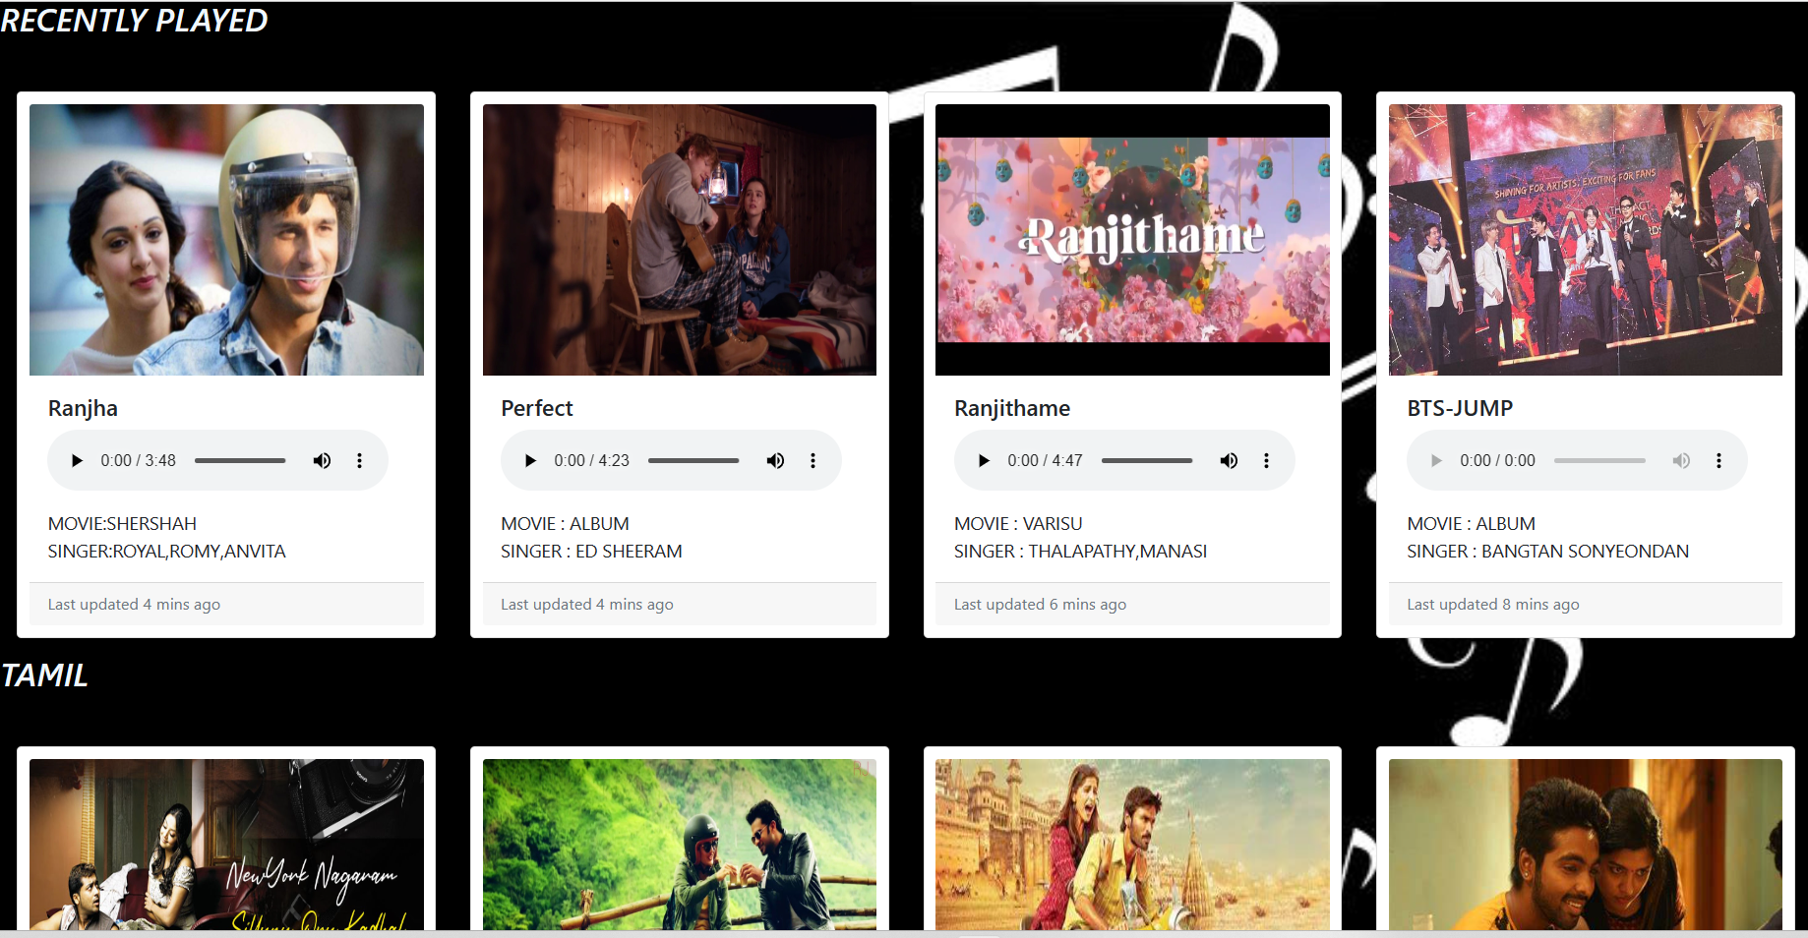
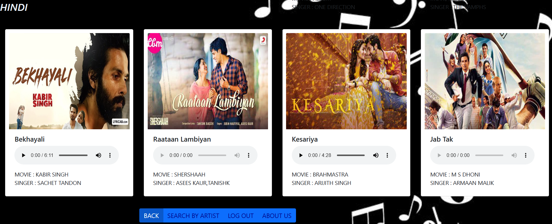
Home page
searching by language on a musical website can provide a more inclusive and personalized user experience, making it easier for users to find the music they want to listen to, and promoting cultural diversity and representation on the website.

Slide 6

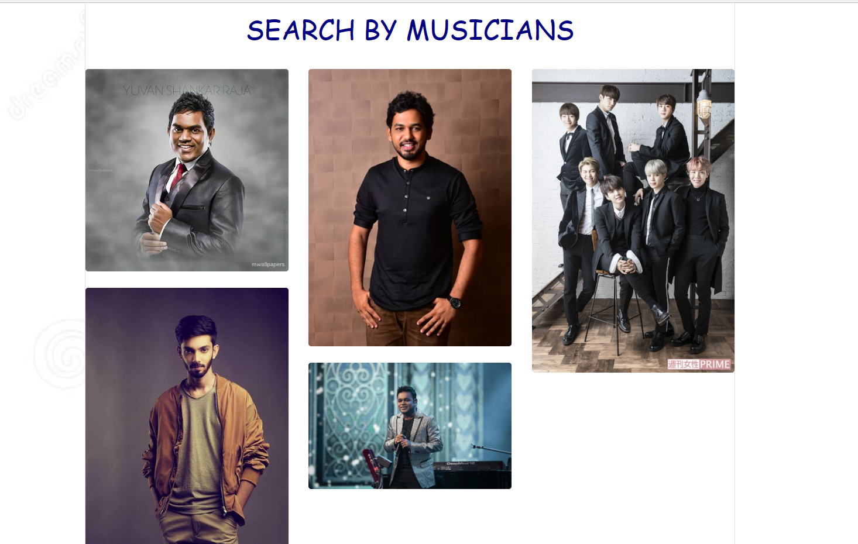
Search by Artist

Slide 7
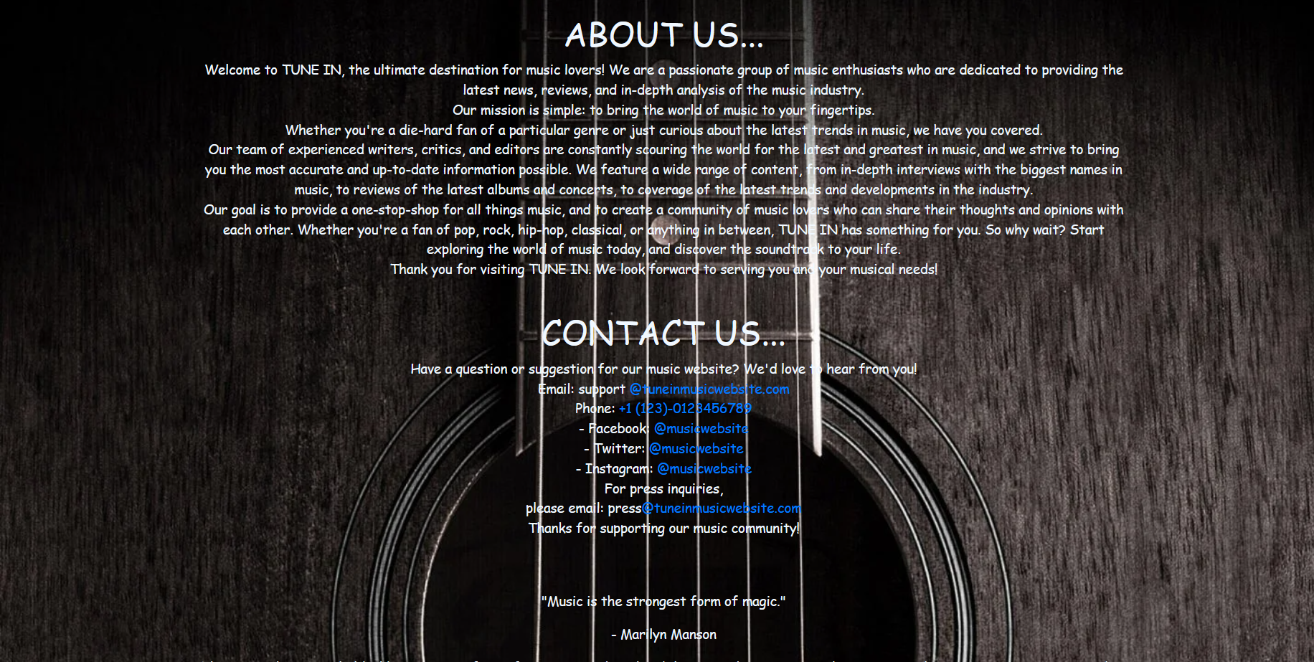
The "About Us" page can be used to introduce the website to visitors.
About page

Slide 8
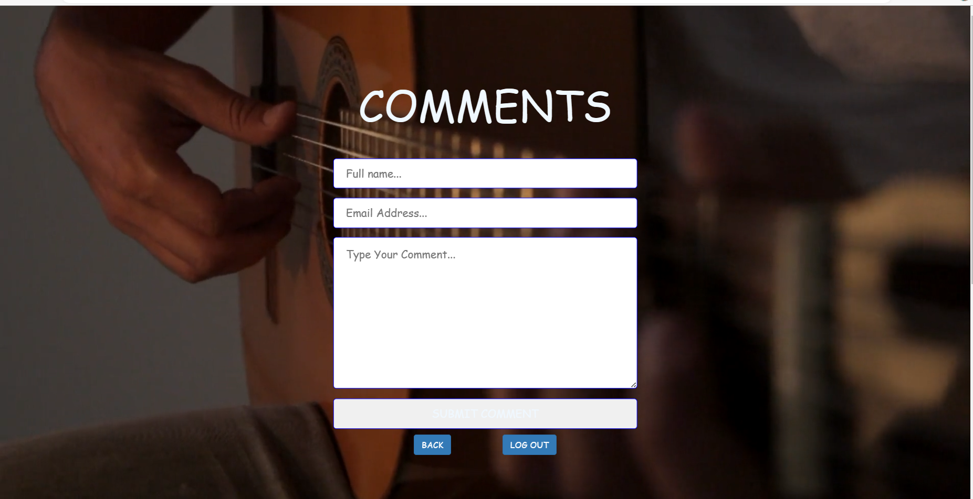
Comment page
The comment page can be used to encourage feedback from visitors to the website.

Slide 9
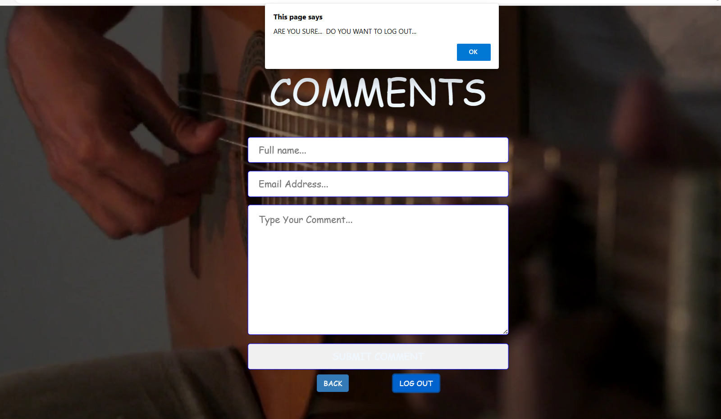
Java Script Alert
The user may unknowingly press the logout option and this helps to get notify that we are sure to log out

Slide 10


